Slide 1





The Challenge & The Solution
Making Spotify Smarter:
Data-Driven Recommendations to Boost Artist Growth and Listener Engagement
Dhruvsuta Pal
24201010063

Slide 2


How can we use the Spotify dataset to figure out the best way to make music, package it, and promote it to grow the platform?

Slide 3
The Data: Spotify track, album, and artist details (popularity scores, followers, genres, etc.).
My Approach (The Steps):
Data Cleaning: Had to fix date formats, fill in missing genres, and remove duplicate tracks to make sure the numbers were right.
Visual Exploration: Used Matplotlib and Seaborn (with a cool Spotify theme!) to find correlations and patterns.
12 Actionable Ideas: Turned every graph into a concrete piece of advice the business can actually use.

Slide 4


Step 1: Cleaning the Data Mess
What I Fixed:
Date Problem: Converted the release date to just the release_year for time-series analysis.
Missing Data: Filled in any missing artist_genres so the genre analysis wouldn't break.
Duplicates: Removed duplicate tracks, making sure to keep the version with the highest track_popularity score (the 'hit' version).
The Result:
The analysis now uses a clean dataset of [Reference data.shape[0] from script] unique, high-quality tracks.

Slide 5
How Long Should a Track Actually Be?
Key Finding: The highest density of popular tracks clusters tightly between 2.5 and 3.5 minutes. Anything longer than 4 minutes sees a steep drop in average popularity.
Business Idea (Duration): Advise our artists: keep it tight! Focusing on the 2.5-3.5 minute range is the best way to maximize listener completion rates.

Slide 6
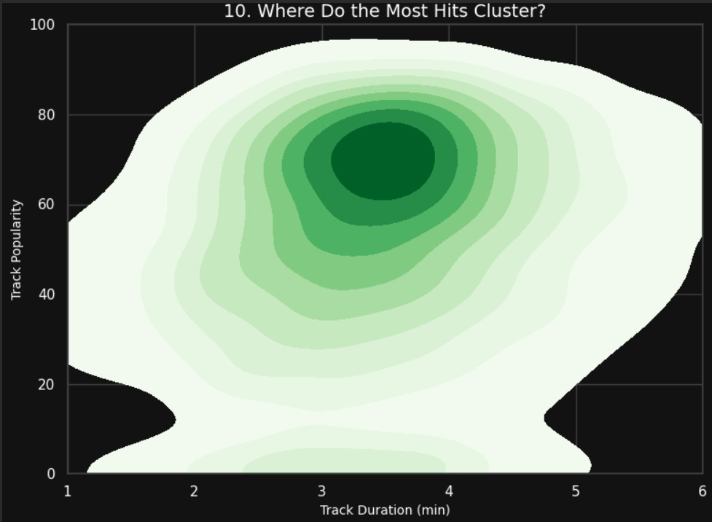
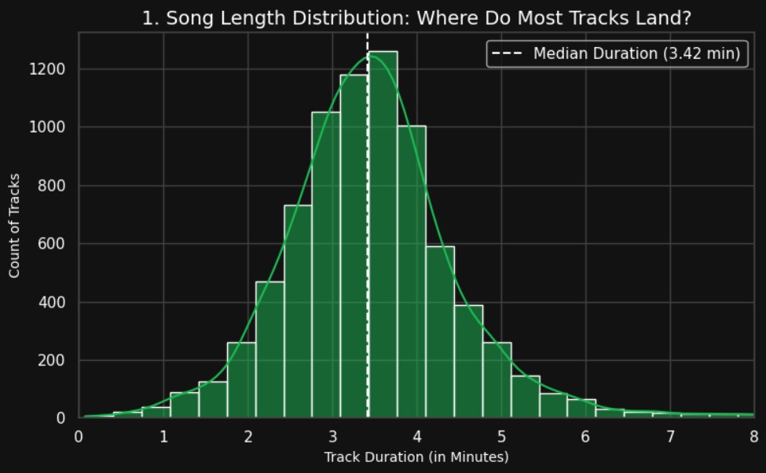

Slide 7
The Best Way to Drop New Music (Singles vs. Albums)
Visualization: Album vs. Single:
Which Format Gets More Popularity? AND Album Fatigue: The Ideal Track Count .
Key Finding 1: Tracks released as Singles are slightly more popular on average than album tracks.
Key Finding 2: Albums that are too long suffer from 'listener fatigue,' causing the average track popularity to drop. 10-14 tracks is the ideal length.
Business Idea (Format): Promote a 'Single-First' model to build hype. Coach artists to target a 10-14 track album length for maximum engagement per track.

Slide 8
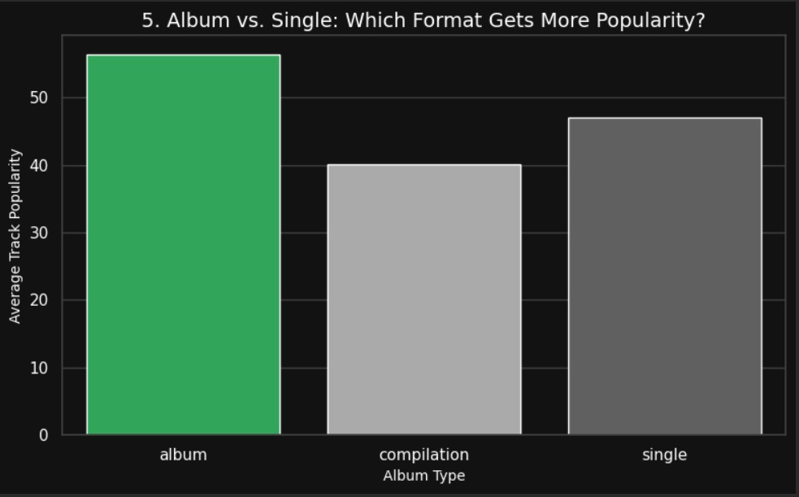
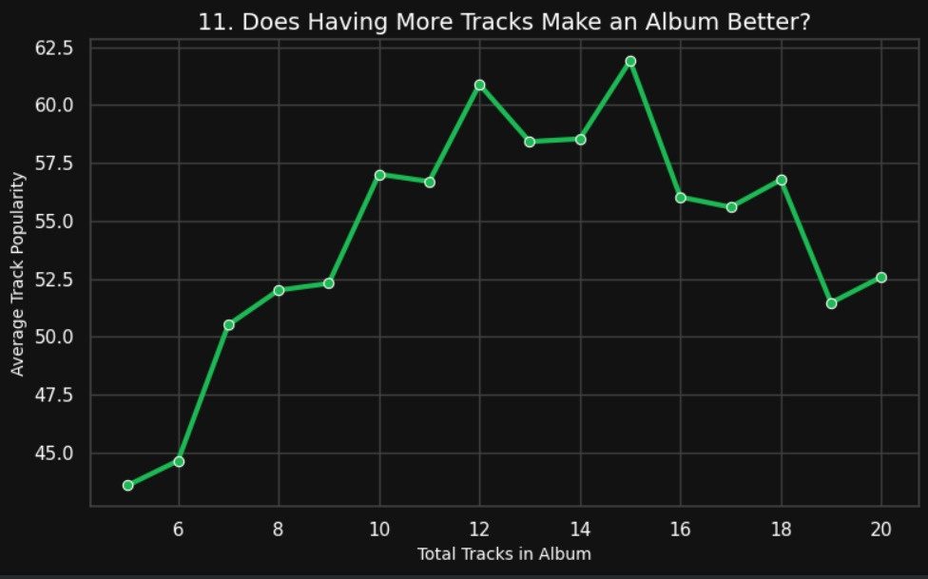

Slide 9
Tracklist Secrets: Order and Content
Visualization:
Does Being Explicit Help or Hurt Popularity? AND Track Position in Album: Does Order Matter?
Key Finding 1 (Explicit): Explicit tracks are only marginally more popular. Sometimes, being explicit limits playlist and radio success.
Key Finding 2 (Order): Popularity peaks sharply at Track #1 and #2. After track 3, people start tuning out.
Business Idea (Arrangement): Tell artists to front-load their albums: put the absolute biggest tracks in the first two slots. Also, encourage "clean" versions of hits for wider distribution.

Slide 10
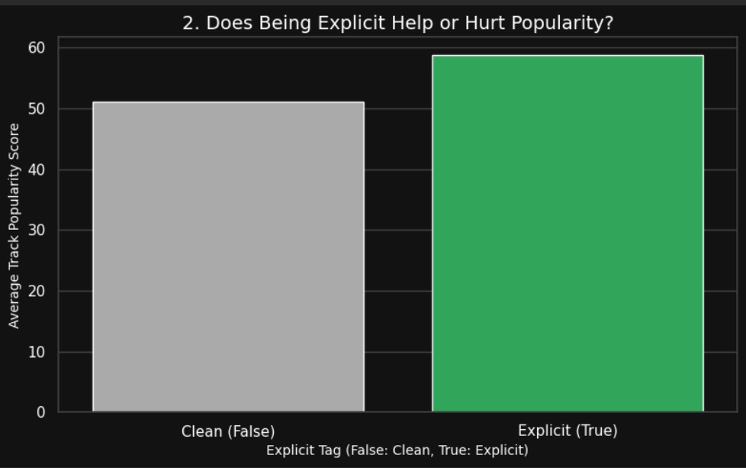
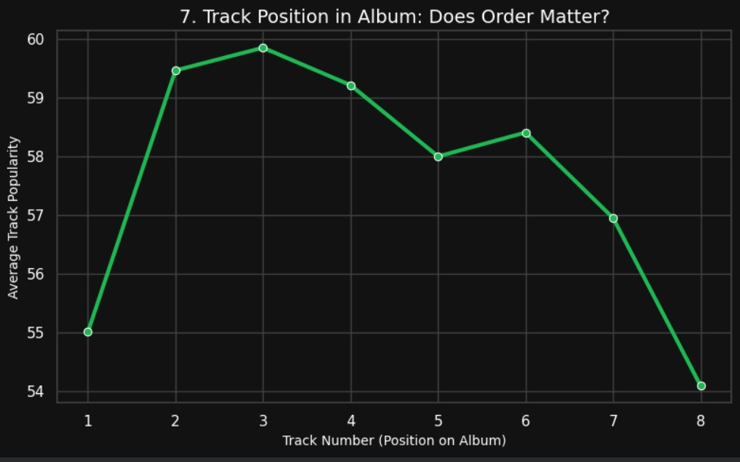

Slide 11
Genre Strategy: Investing in Blockbusters and Niche Gems
Visualization: The Top 10 Genres by Average Hit Potential AND Small but Mighty: Top 5 Niche Genres.
Key Finding 1 (Top 10): These are the cash cows. They guarantee baseline high success.
Key Finding 2 (Niche): I found small genres with very high average popularity, meaning a dedicated audience is currently underserved.
Business Idea (Investment): Keep securing content in the top 10. Crucially, invest editorial time (creating niche playlists) in the Niche Genres—this builds loyalty and engagement among highly passionate fans.

Slide 12
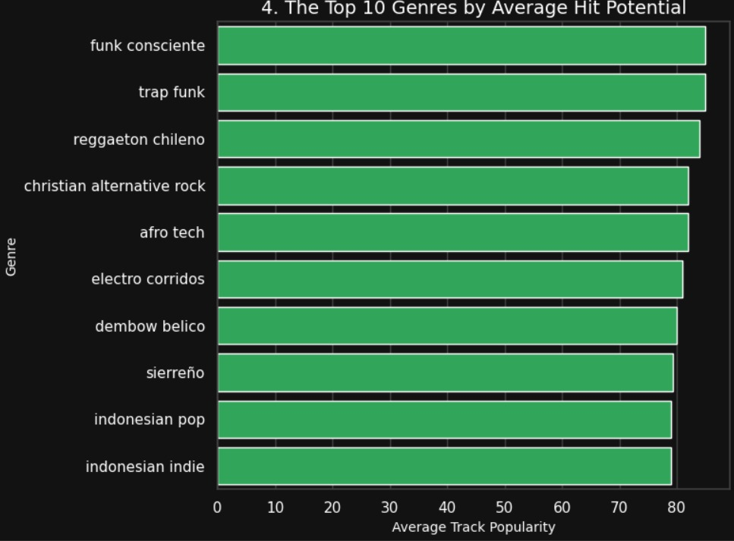
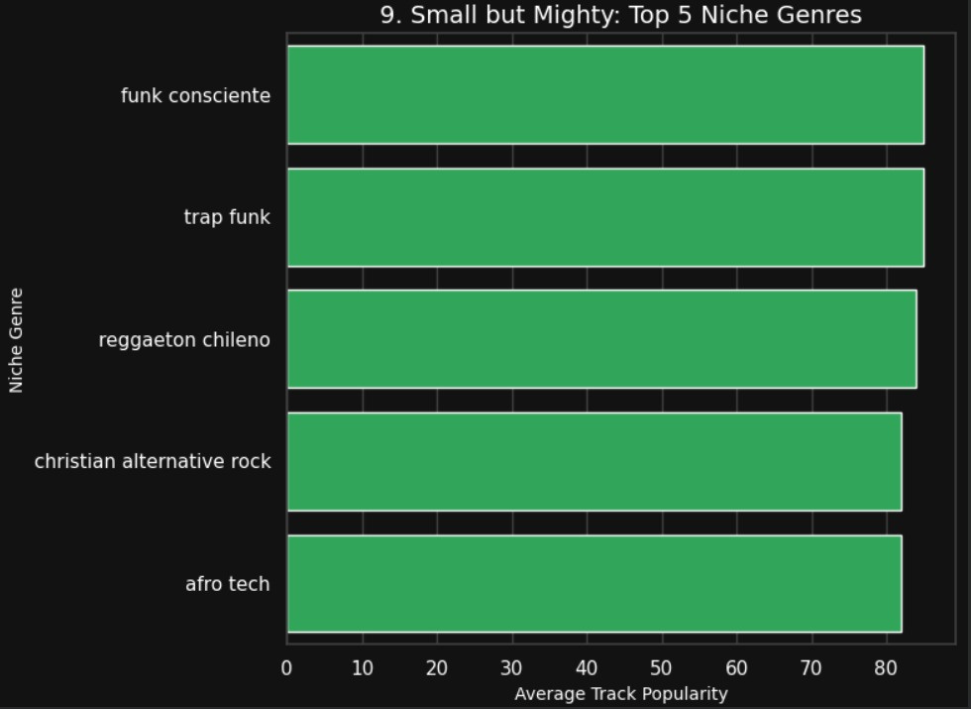

Slide 13
Nostalgia is Gold: Monetizing the Back Catalog
Visualization: Does Old Music Stay Popular? Track Popularity Over Time .
Key Finding: Older songs from certain eras (like the 80s/90s) show unexpected popularity spikes today. People love throwbacks!
Business Idea (Monetization): Launch automated 'Decade Spotlight' and 'Throwback' campaigns. This is a zero-cost way to generate revenue from old content that's already in the library.

Slide 14
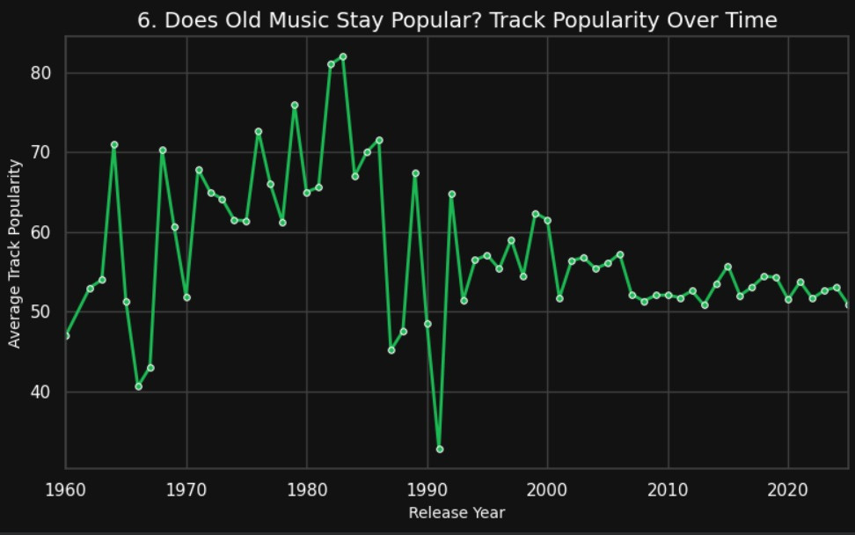

Slide 15
Artist Development: Finding the Next Superstar
Visualization: Track Popularity Across Different Artist Size Tiers AND Finding Hidden Gems: Popularity vs. Followers .
Key Finding 1 (Tiers): Pushing a Micro-Artist (1K-100K followers) into the next tier gives us the best return for the lowest investment.
Key Finding 2 (Potential): I identified a group of artists with very high popularity scores (meaning the algorithm loves them) but low followers. They are ready to explode.
Business Idea (Growth): Stop overspending on established stars. Move resources to the Micro-Artists and High-Potential list to rapidly scale our new talent pipeline.

Slide 16
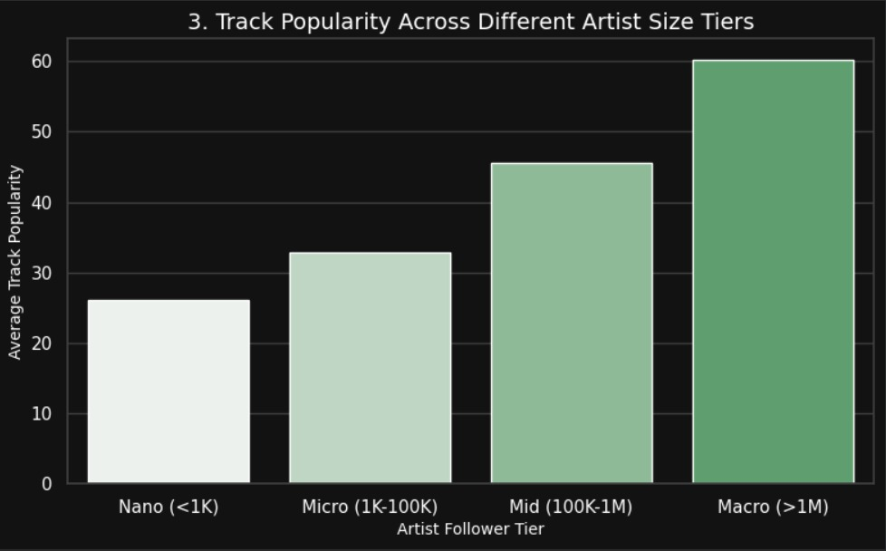
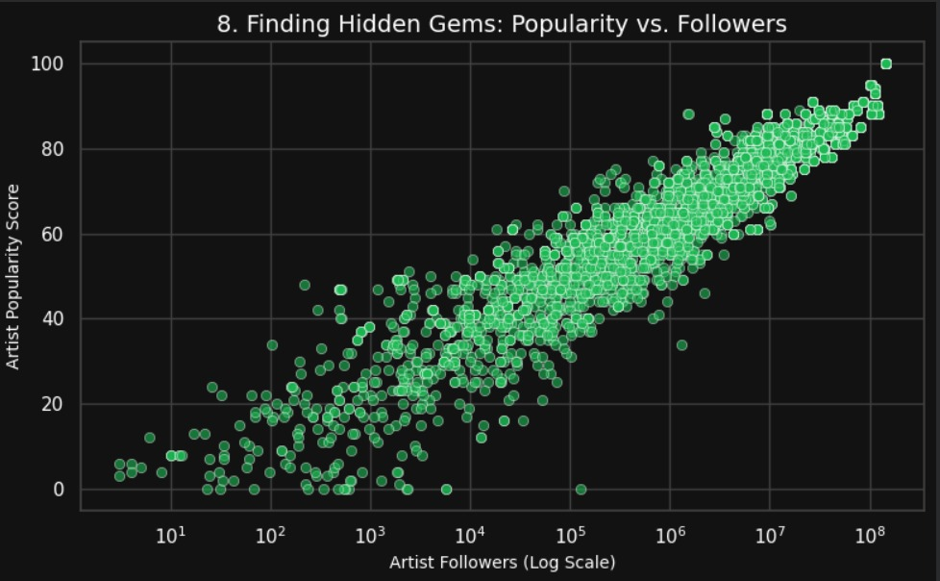

Slide 17
Converting Casual Listeners into Loyal Fans
Visualization: Track is Way More Popular Than Artist .
Key Finding: These tracks are huge hits (viral, top playlists) but their artists haven't converted the listeners into followers. There's a big gap between track success and artist loyalty.
Business Idea (Conversion): Target listeners of these specific viral tracks immediately with 'Artist Spotlight' ads and 'More Like This' suggestions. This is the fastest way to build an artist's loyal fanbase.

Slide 18
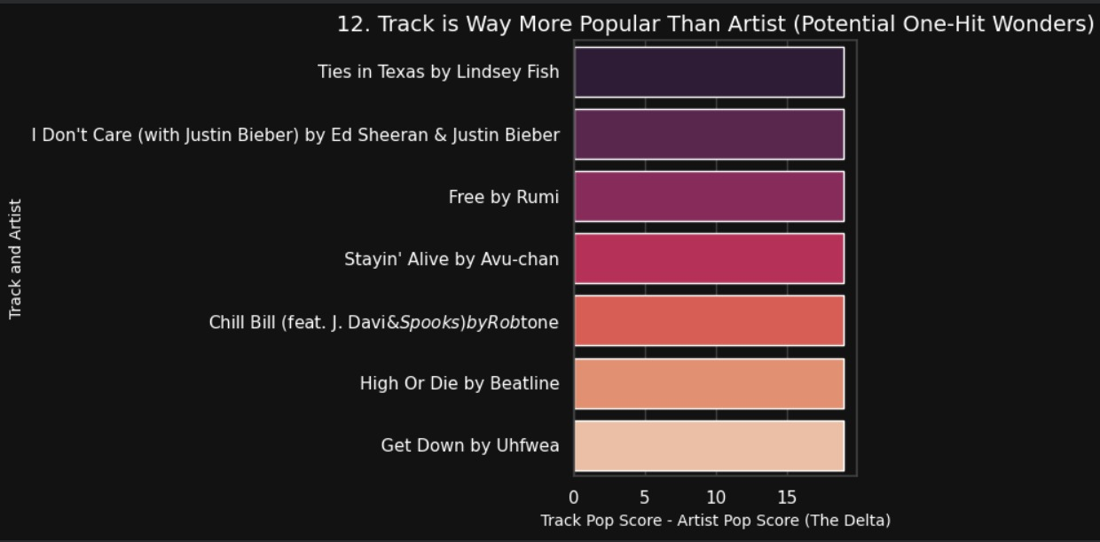

Slide 19
Final Takeaways: Simple Rules for Success
Top 3 Actions:
Be Short & Focused: Aim for 2.5 to 3.5 minute tracks and 10-14 song albums.
Invest Smart: Target Micro-Artists and underserved Niche Genres.
Don't Waste the Hits: Use the 'Pop Delta' to convert casual listeners into fans.
Future Work: The next step is to analyze the audio features (like 'danceability' and 'energy') to make my 'Hit Predictor' even better!

Slide 20
THANK YOU!!!

